Slide 1
Access to the unreachable web site
Nu1L

Slide 2
First, the program will check the password, the key is in file ./AES_KEY but we don’t know.
You can use \x00 bypass the check

Slide 3
Notes:
The normal function of homurasocks is to Decrypt the request packets from user and send them to the web service at port 9577 and encrypt the response and send to user.

Slide 4
Vulnerability:
Read fail will return -1
Notes:
When read long data and try to write to unwritable address. read function will return -1 (minus one).

Slide 5
And then overwrite the port to 8080 ,password to 0,it will read password again if password is 0
And overwrite key file name to any file you can predict the first 16 bytes of the file content such as /etc/passwd which should be “root:x:0:0:root:”, and it will be the password.

Slide 6
It is very easy, and it should work at local.
BUT you may fail at remote server.
It is not a bug , it is a feature！
That is intended.
The default MTU is 1500.
Server can not receive too long data at one time because of ip fragmentation, and the overwrite will fail.
Notes:
It’s easy and it should work at local but you may fail when connect to the remote server because of ip fragmentation.

Slide 7
But if the pieces do not in sequence.
It has to reassemble the packet and pass it to the higher protocol layer after it received all pieces.
You can use libnetfilter_queue to reorder the pieces.
And then you can access the site at port 8080.

Slide 9
Java Chall
Shiro 1.2.4 Unserialize RCE
Intended solution: New payload in Commons-Collections-3.2.1 without LazyMap and TransformedMap
Unintended solution: CommonsBeanutils

Slide 10

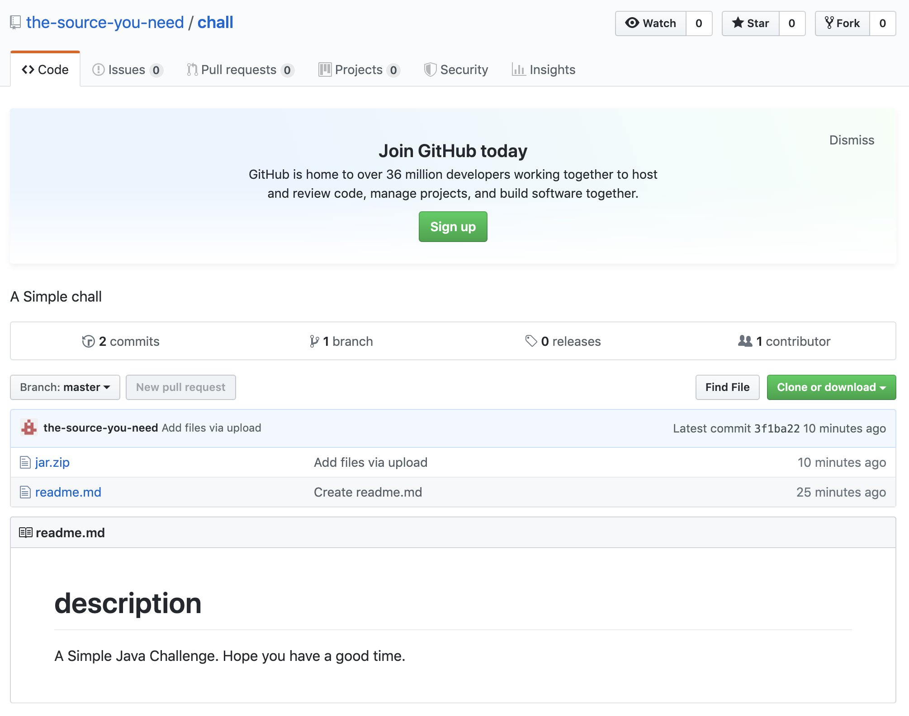
Java Chall

Slide 11
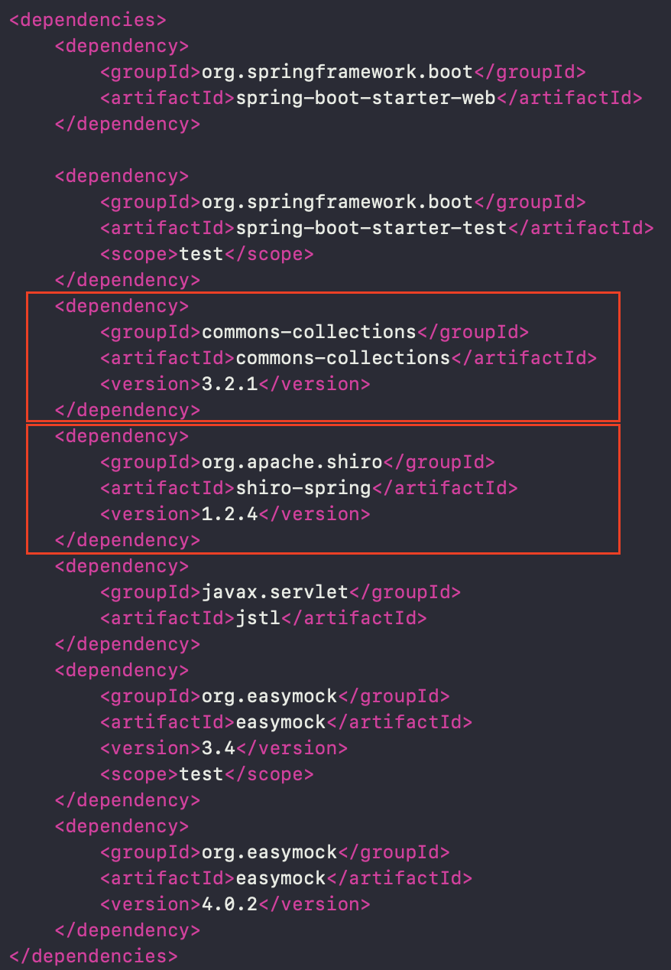
Java Chall
We can find commons-collections 3.2.1 and apache shiro 1.2.4 in pom.xml .

Slide 12
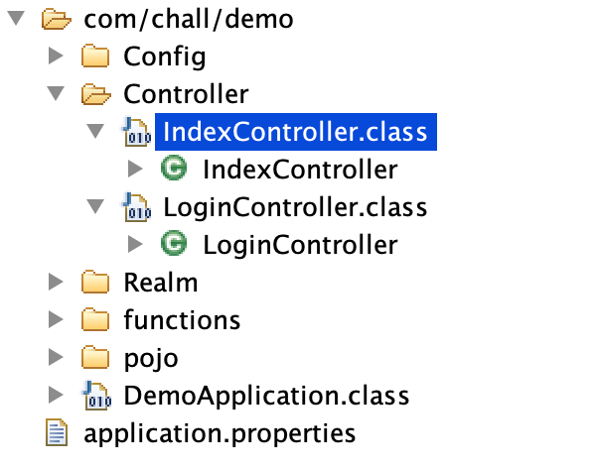
Java Chall
We can see the file directory structure is as follows：

Slide 13
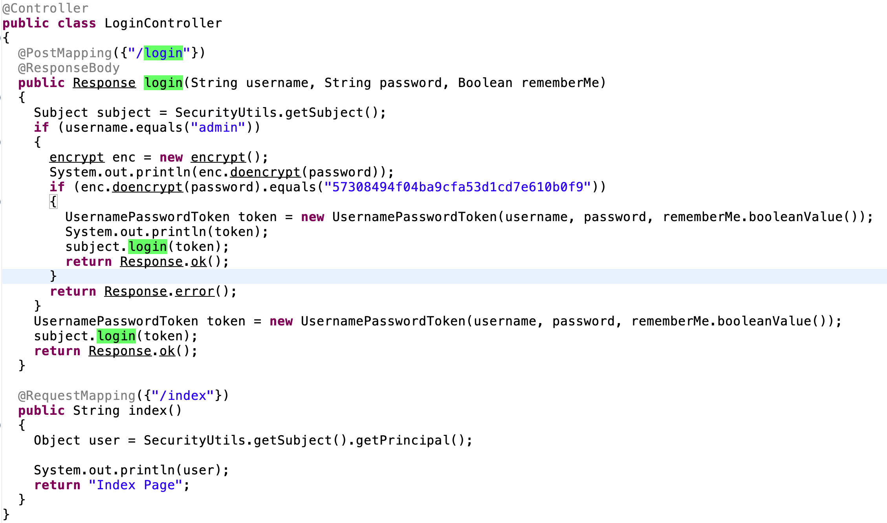
Java Chall
Login
authenticate

Slide 14
Java Chall
Controllable cookie can lead to unserialize RCE in shiro(1.2.4).
We can use commons collections in pom.xml to construct the gadget.

Slide 15
Java Chall
Existing payloads in ysoserial are useless.
when compare the commons-collections 3.2.1.jar in demo jar file with the offical jar file, we can find the known exploit ways in commons collections(TransformedMap and LazyMap) have been baned: change the source code and then recompile the jar

Slide 16
Java Chall
So we need to find a new way to exploit shiro with commons collections.

Slide 17
DefaultedMap
For Convenience, we use LazyMap here as an example.

Slide 18
DefaultedMap
BadAttributeValueExpException.readObject
TiedMapEntry.toString
TiedMapEntry.getValue
LazyMap.get
ChainedTransformer.transform
InvokerTransformer.transform

Slide 19
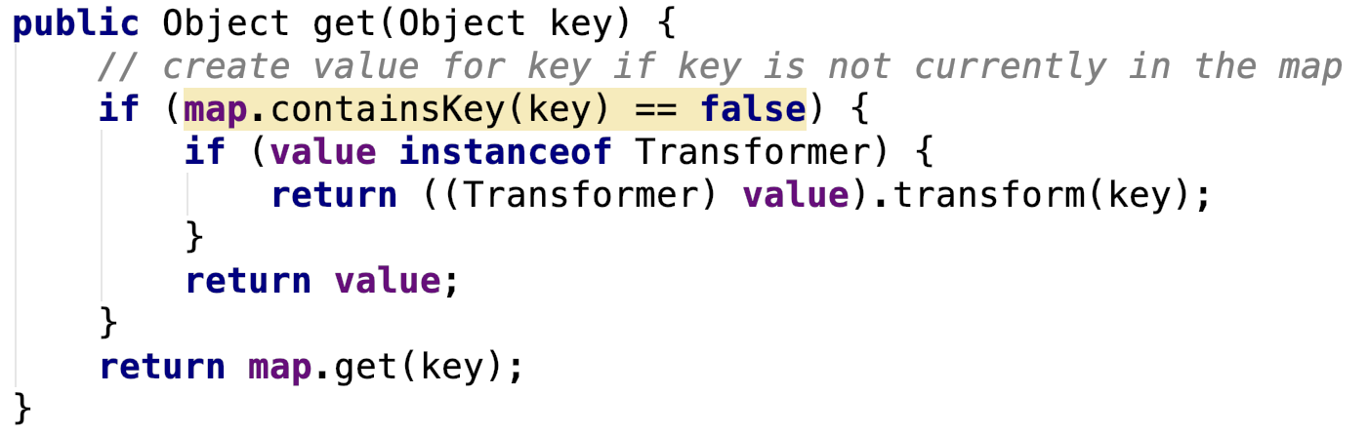
DefaultedMap
In DefaultedMap, the function ”get” calls method transform:

Slide 20
DefaultedMap
In LazyMap, we can use method decorate in LazyMap to set the factory variable to be instance of Transfromer.
In DefaultedMap, it limits the instance type of variable value to be Transformer. We can use the decorate method to complete the instance create -- Just like LazyMap.
So, we can find that the trigger way in DefaultedMap and LazyMap is very similar.

Slide 21
DefaultedMap
Combined with the above, we can draw the trigger order again:
BadAttributeValueExpException.readObject
TiedMapEntry.toString
TiedMapEntry.getValue
LazyMap.get
ChainedTransformer.transform
InvokerTransformer.transform

Slide 22
DefaultedMap
We can follow the exploit way of LazyMap which is written in ysoserial to complete the exploit of DefaultedMap.
Add a new payload into ysoserial, and recompile the ysoserial.

Slide 23
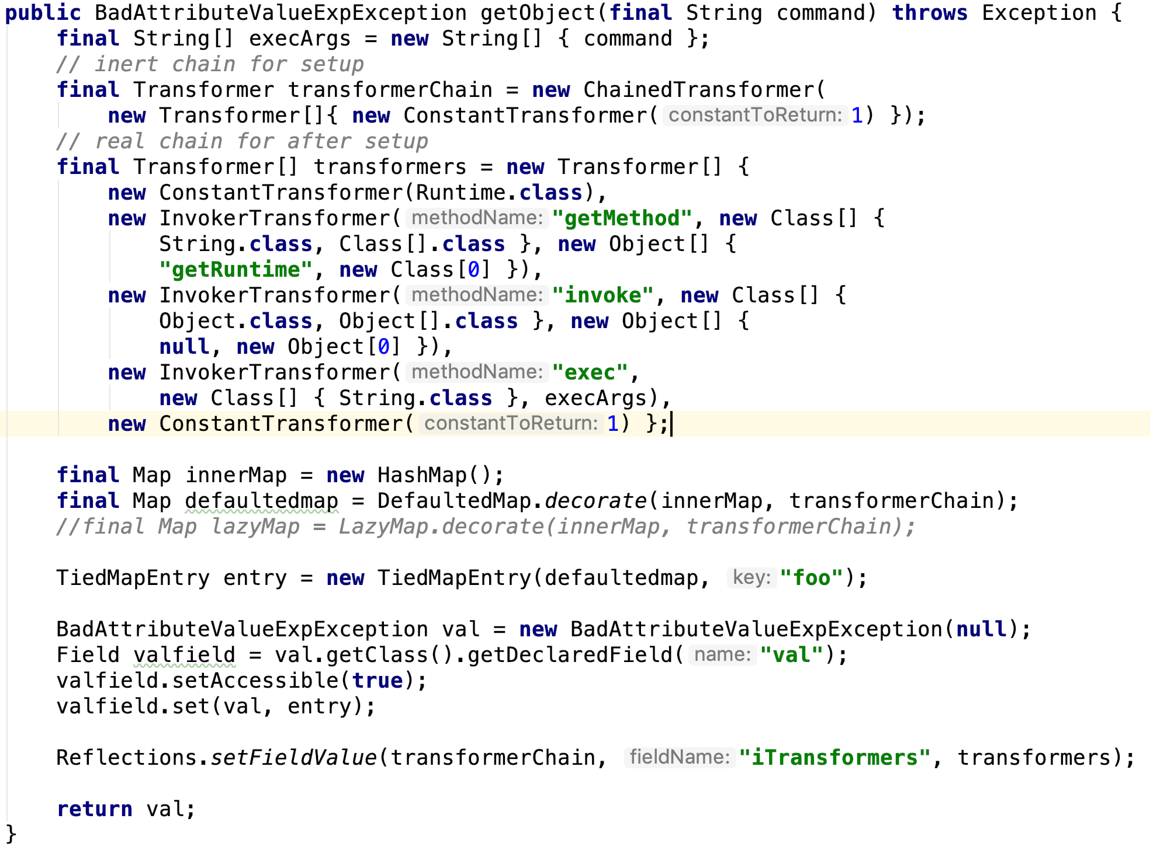
Exploit

Slide 24
Note
How to exploit shiro?
You can use the JRMP module which in ysoserial.The details of how to use is written in Orange’s blog: http://blog.orange.tw/2018/03/pwn-ctf-platform-with-java-jrmp-gadget.html

Slide 25

Contact
@AkemiHomura_YC
@Meizjm3i
You may need source in
https://github.com/meizjm3i/WCTF2019

Slide 26
Thanks!

